Slide 1
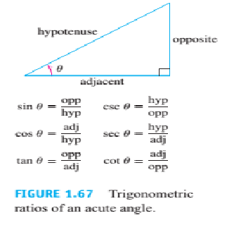
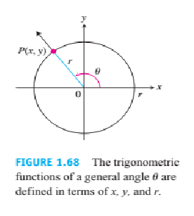
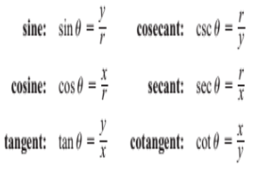
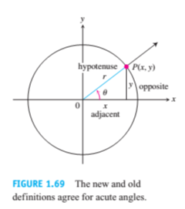
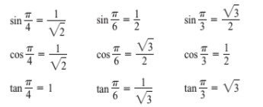
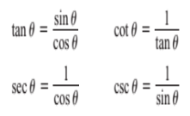
Mathematics Materials Lecturer A.M.Alazzawe FIRST CLASS
SEMESTER ONE
CHAPTER Six
1.6
Trigonometric Functions
The define the trigonometric functions in terms of the coordinates of the point P(x, y) where the angle’s terminal
ray intersects the circle (Figure 1.68).
1

Slide 2
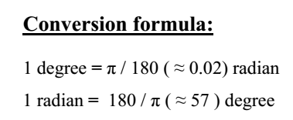
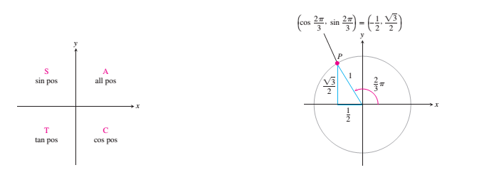
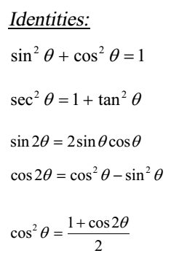
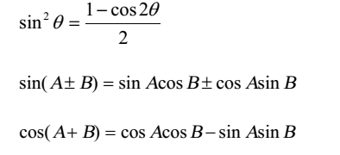
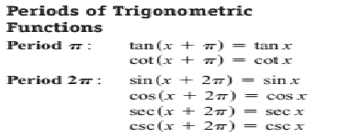
Mathematics Materials Lecturer A.M.Alazzawe FIRST CLASS
SEMESTER ONE
The CAST rule (Figure 1.70) is useful for remembering when the basic trigonometric functions are positive or
negative
The CAST rule, remembered by the statement “All Students Take Calculus,” tells which trigonometric functions
are positive in each quadrant
2

Slide 3
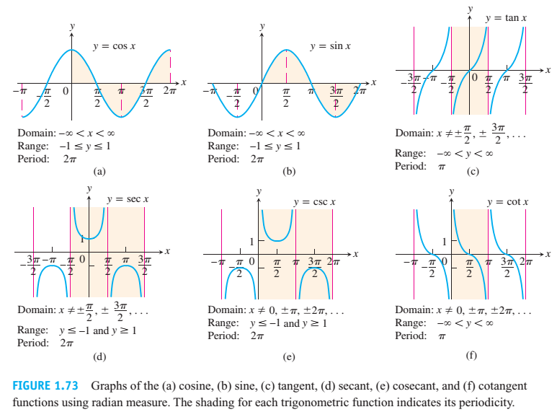
Mathematics Materials Lecturer A.M.Alazzawe FIRST CLASS
SEMESTER ONE
Graphs of trigonometric functions
When we graph trigonometric functions in the coordinate plane, we denote the independent
variable (radians) by x instead of θ.
Even and odd trigonometric functions
The graph in the above figures suggest that cos θ and sin θ are even functions because their graphs
are symmetric about the y-axis. The other four basic trigonometric functions odd.
3

Slide 4
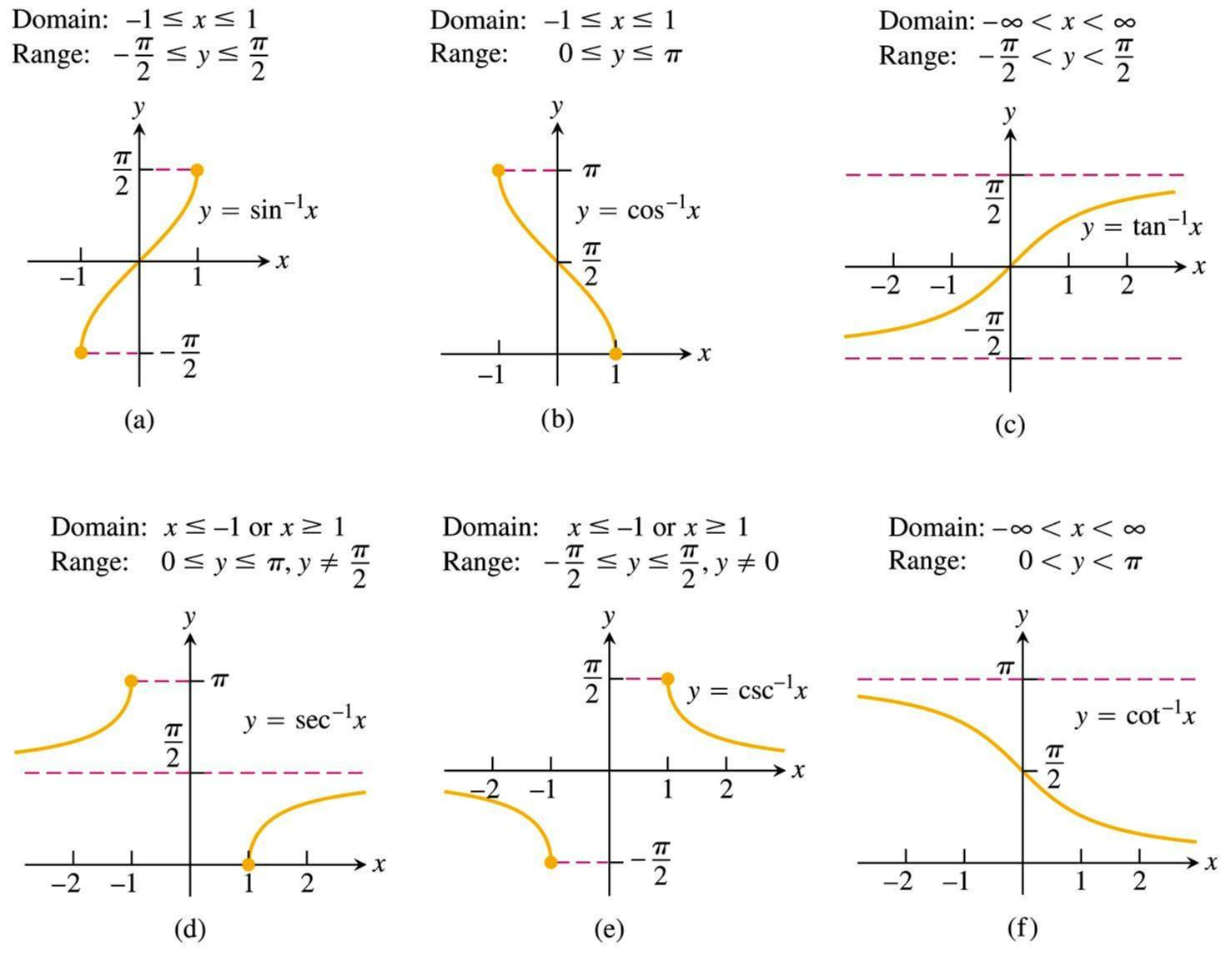
Mathematics Materials Lecturer A.M.Alazzawe FIRST CLASS
SEMESTER ONE
Inverse trigonometric functions and their graphs
Inverse Trigonometric functions
The inverse trigonometric functions are the inverse functions of the trigonometric functions, written
,
,
,
,
, and
.
Sec
-1
=1/Cos = Cos,
-1
Csc =1/Sin = Sin,
-1
Cot =1/Tan = Tan
4

Slide 5
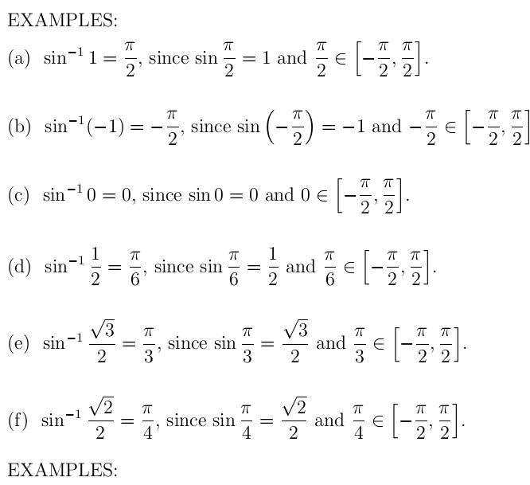
Mathematics Materials Lecturer A.M.Alazzawe FIRST CLASS
SEMESTER ONE
5

Slide 6
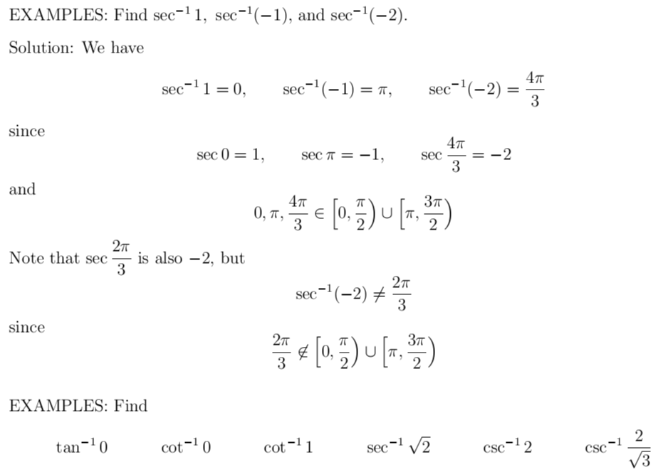
Mathematics Materials Lecturer A.M.Alazzawe FIRST CLASS
SEMESTER ONE
❖ Basic idea: To find sec
-1
2, we ask "what angle has secant equal to 2?" The answer is 60°. As a result we
-1
-1
say that sec 2 = 60°. In radians this is sec
2 = π/3.
❖ More: There are actually many angles that have secant equal to 2. We are really asking "what is the
simplest, most basic angle that has secant equal to 2?" As before, the answer is 60°. Thus sec
-1
2 = 60° or
sec
-1
2 = π/3.
❖ Details: What is sec
-1
(–2)? Do we choose 120°, –120°, 240° , or some other angle? The answer is 120°.
With inverse secant, we select the angle on the top half of the unit circle. Thus sec
2) = 2π/3.
-1
(–2) = 120° or sec
-1
(–
Note: sec 90° is undefined, so 90° is not in the range of sec-1
Can use this formula
or
6

Slide 7
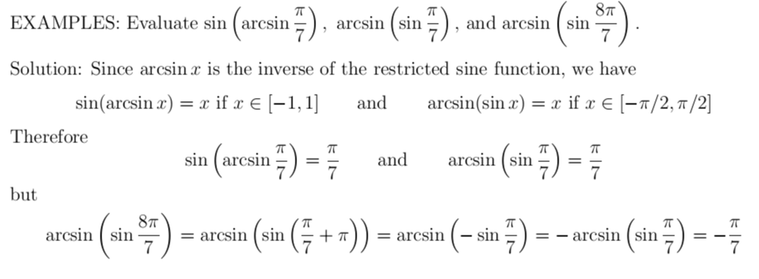
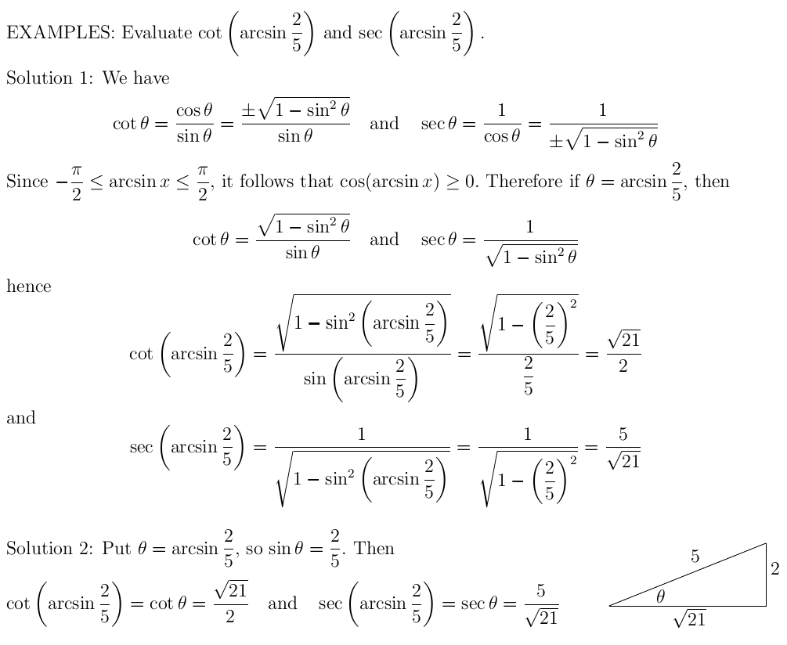
Mathematics Materials Lecturer A.M.Alazzawe FIRST CLASS
SEMESTER ONE
7

Slide 8
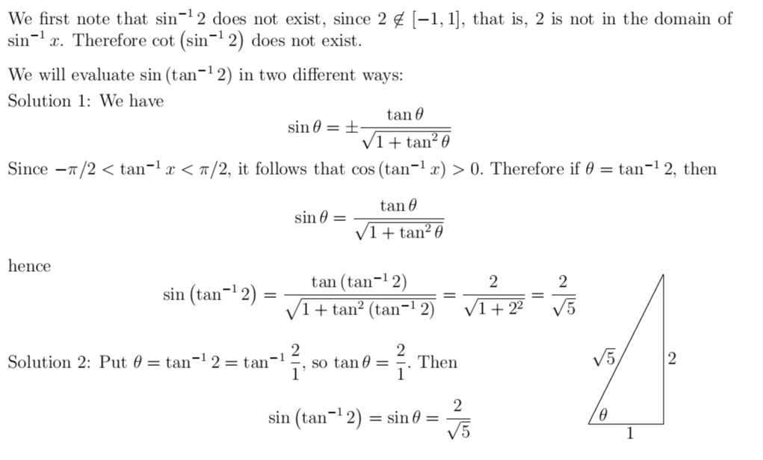
Mathematics Materials Lecturer A.M.Alazzawe FIRST CLASS
SEMESTER ONE
8

Slide 9
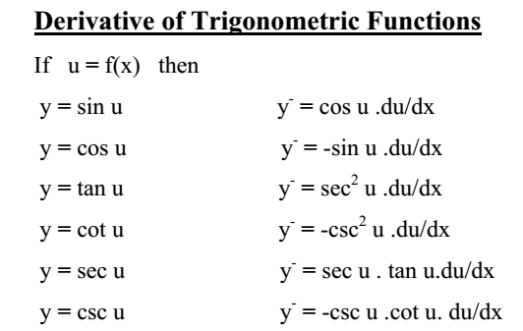
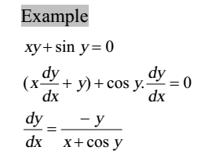
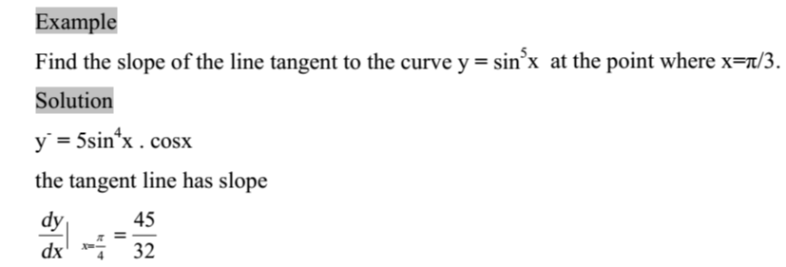
Mathematics Materials Lecturer A.M.Alazzawe FIRST CLASS
SEMESTER ONE
9

Slide 10
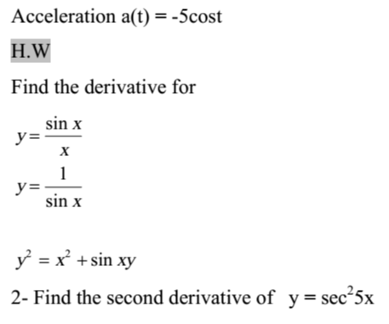
Mathematics Materials Lecturer A.M.Alazzawe FIRST CLASS
SEMESTER ONE
10

Slide 11
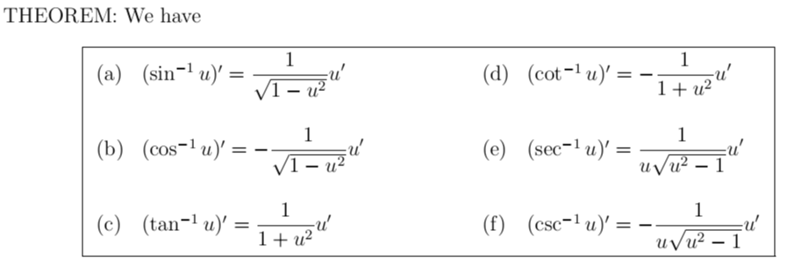
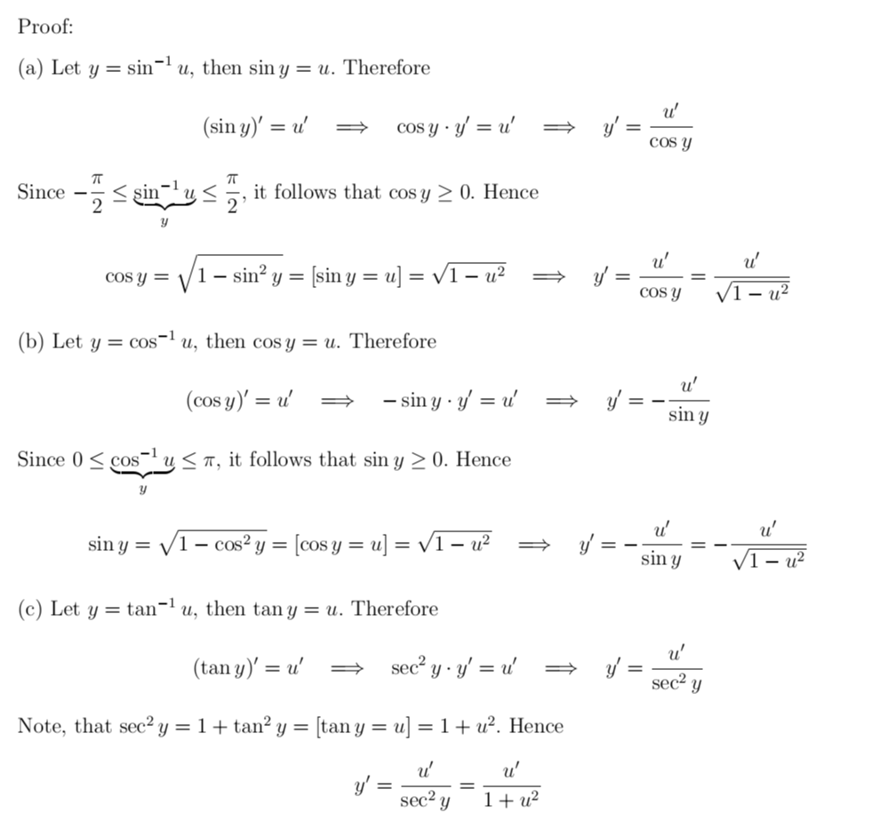
Mathematics Materials Lecturer A.M.Alazzawe FIRST CLASS
SEMESTER ONE
11

Slide 12
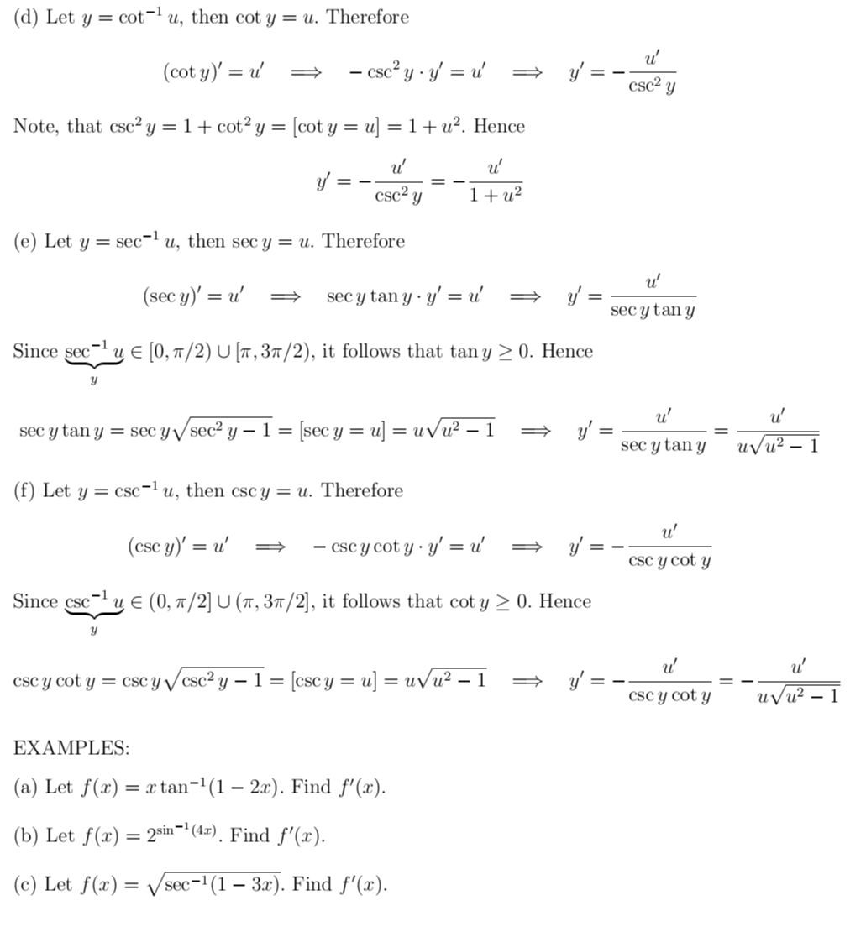
Mathematics Materials Lecturer A.M.Alazzawe FIRST CLASS
SEMESTER ONE
12

Slide 13
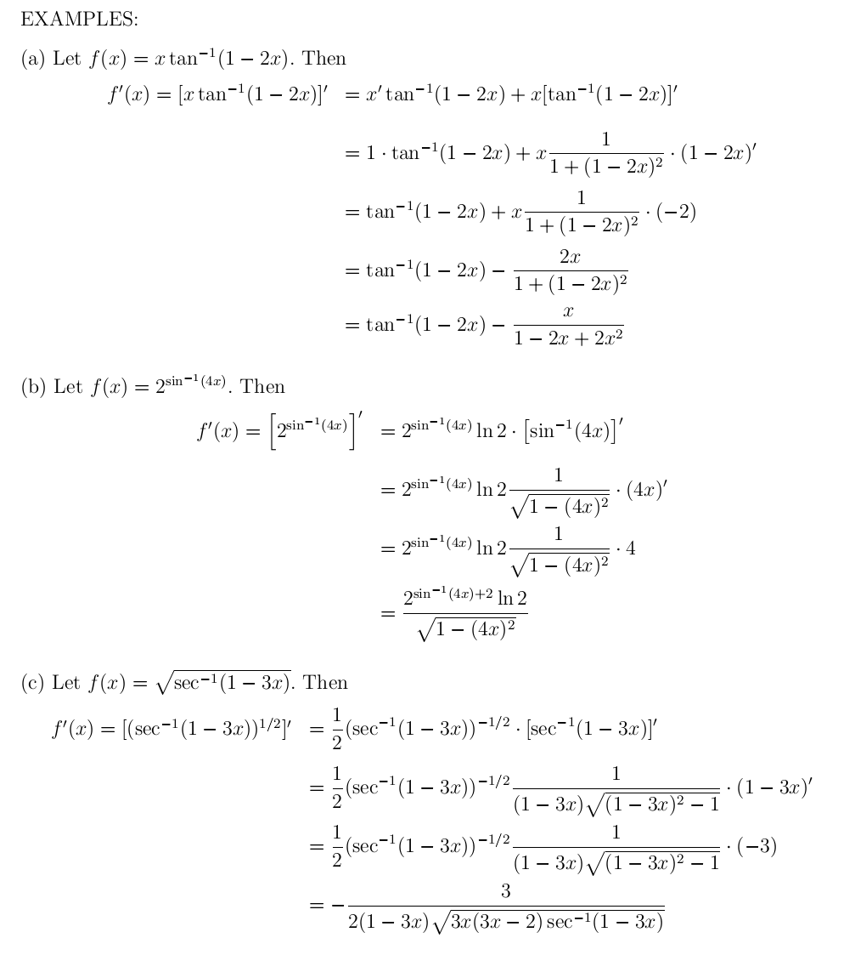
Mathematics Materials Lecturer A.M.Alazzawe FIRST CLASS
SEMESTER ONE
13

Slide 14
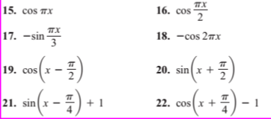
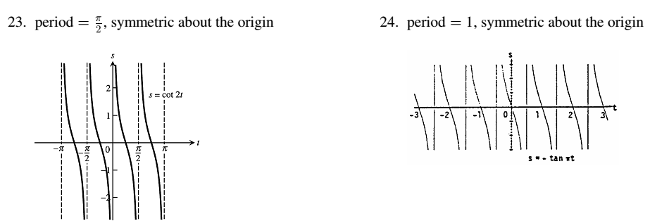
Mathematics Materials Lecturer A.M.Alazzawe FIRST CLASS
SEMESTER ONE
Solved question
Solution
Solution
14

Slide 15
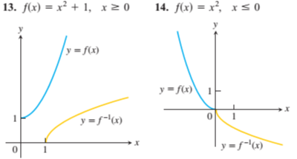
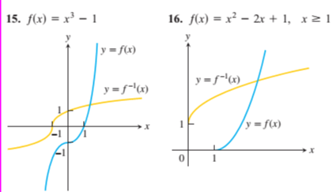
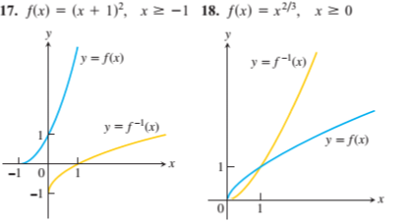
Mathematics Materials Lecturer A.M.Alazzawe FIRST CLASS
SEMESTER ONE
Inverse trigonometric
Solution
15

Slide 16
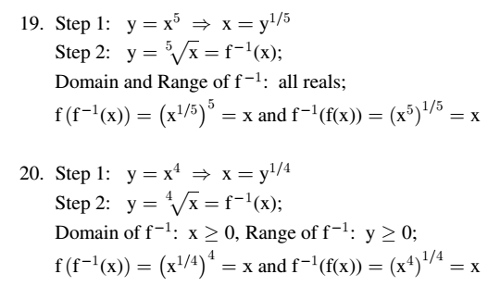
Mathematics Materials Lecturer A.M.Alazzawe FIRST CLASS
SEMESTER ONE
16

Slide 17
Mathematics Materials Lecturer A.M.Alazzawe FIRST CLASS
SEMESTER ONE
7.7 عجار
17

